Slide 1
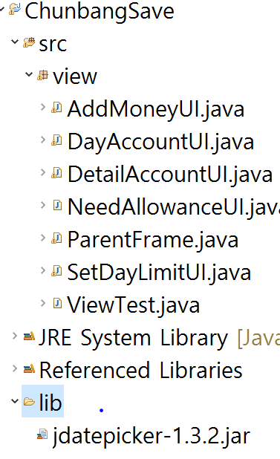
lib 폴더 생성
Lib에 압축파일 copy

Slide 2
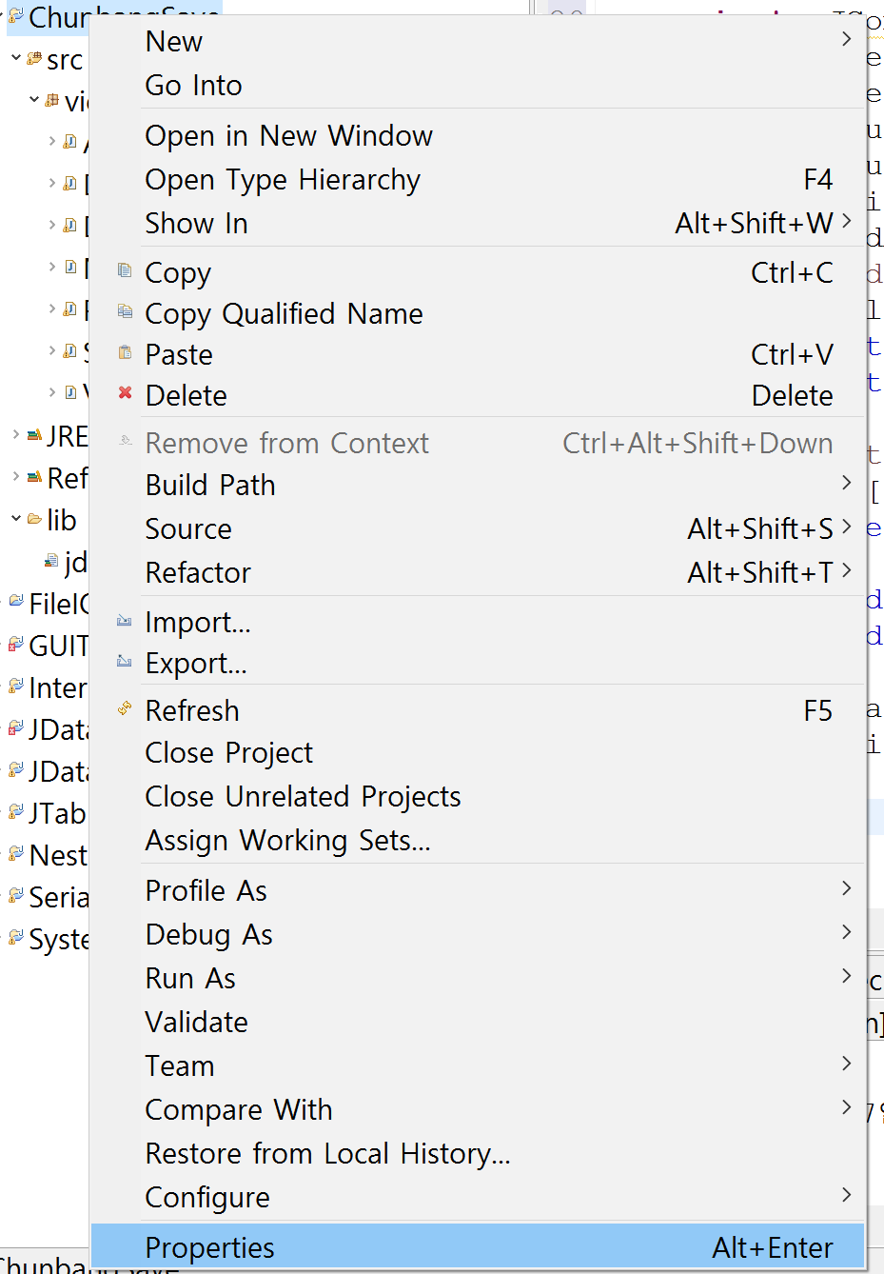
2. properties

Slide 3
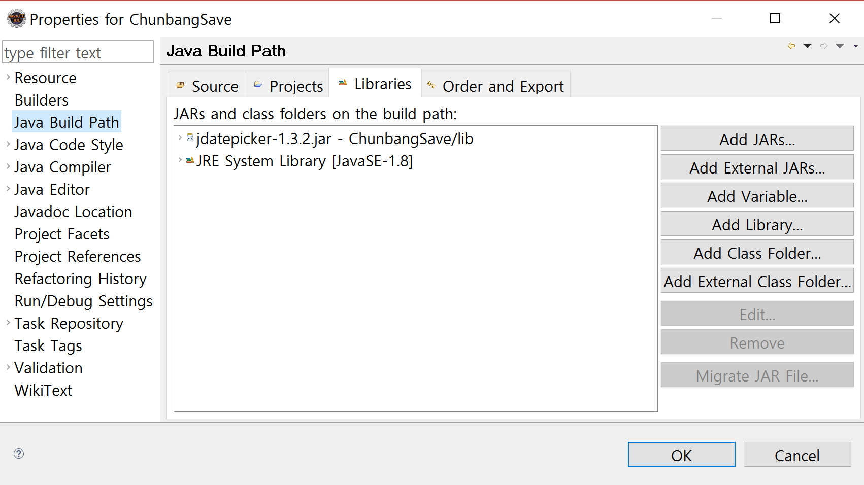
Java build Path클릭
Add JARs..클릭

Slide 4
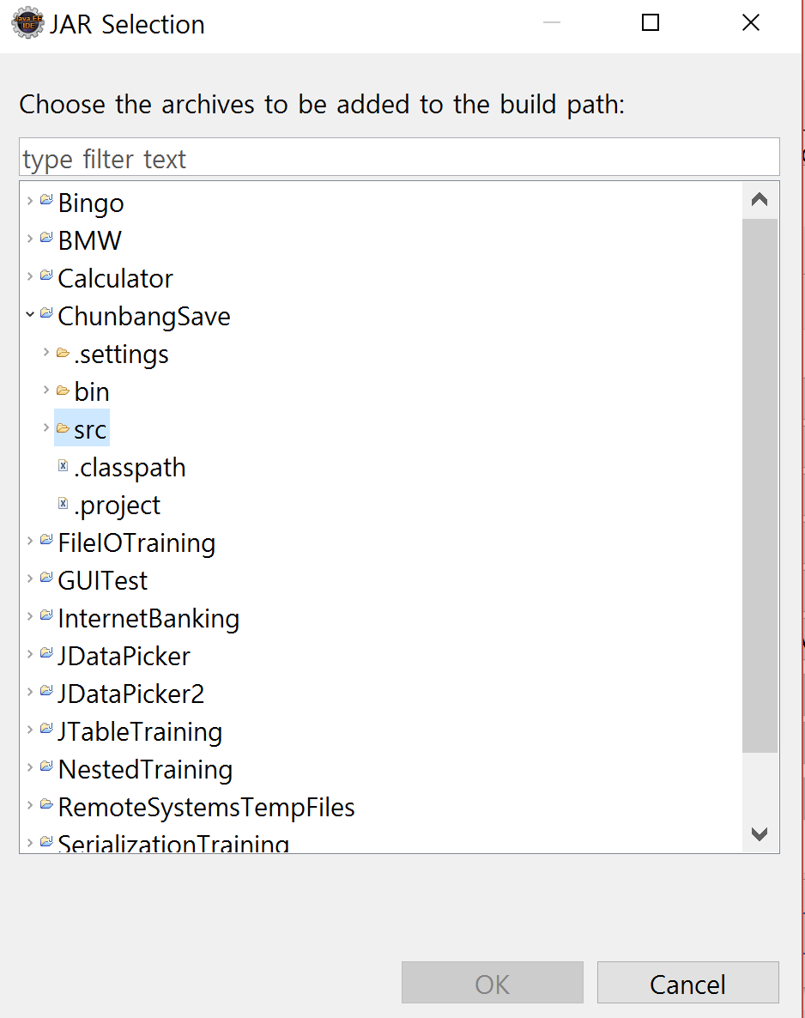
해당 프로젝트 폴더 클릭
아까 만든 lib에 넣어논 알집압축파일 클릭 후 OK

Slide 5
예제 코드
import java.awt.BorderLayout;
import java.awt.Dimension;
import java.awt.event.ActionEvent;
import java.awt.event.ActionListener;
import javax.swing.JButton;
import javax.swing.JFrame;
import net.sourceforge.jdatepicker.impl.JDatePanelImpl;
import net.sourceforge.jdatepicker.impl.JDatePickerImpl;
import net.sourceforge.jdatepicker.impl.UtilDateModel;
public class UserDefinedLabelTest extends JFrame{
public UserDefinedLabelTest() {
UtilDateModel dateModel=new UtilDateModel();
dateModel.setSelected(true);
JDatePanelImpl datePanel = new JDatePanelImpl(dateModel);
JDatePickerImpl datePicker = new JDatePickerImpl(datePanel);
add(datePicker); // 이걸 날짜정보 입력하는 부분 panel에 넣으면되 얘들아!!!!!!!!!!!!!!!!!!!!!!!!!!!!!!
JButton btn=new JButton("클릭");
btn.addActionListener(new ActionListener() {
public void actionPerformed(ActionEvent e) {
System.out.println(dateModel.getYear());
System.out.println(dateModel.getMonth()+1);
System.out.println(dateModel.getDay());
}
});
add(btn,BorderLayout.SOUTH);
pack();
setPreferredSize(new Dimension(1000,1000));
setVisible(true);
}
public static void main(String[] args) {
new UserDefinedLabelTest();
}
}

